Slide 1
Decision tree using Id3 Algorithm from scratch
-Garseri bhavani
(ML Engineer)

Slide 2
Introduction:
The online hotel reservation channels have dramatically changed booking possibilities and customers’ behavior. A significant number of hotel reservations are called-off due to cancellations or no-shows. The typical reasons for cancellations include change of plans, scheduling conflicts, etc. This is often made easier by the option to do so free of charge or preferably at a low cost which is beneficial to hotel guests but it is a less desirable and possibly revenue-diminishing factor for hotels to deal with.
Can you predict if the customer is going to honor the reservation or cancel it ?

Slide 3
Introduction of Attributes:
Booking_ID: unique identifier of each booking
no_of_adults: Number of adults
no_of_children: Number of Children
no_of_weekend_nights: Number of weekend nights (Saturday or Sunday) the guest stayed or booked to stay at the hotel
no_of_week_nights: Number of week nights (Monday to Friday) the guest stayed or booked to stay at the hotel
type_of_meal_plan: Type of meal plan booked by the customer:
required_car_parking_space: Does the customer require a car parking space? (0 - No, 1- Yes)
room_type_reserved: Type of room reserved by the customer. The values are ciphered (encoded) by INN Hotels.
lead_time: Number of days between the date of booking and the arrival date
arrival_year: Year of arrival date
arrival_month: Month of arrival date
arrival_date: Date of the month
market_segment_type: Market segment designation.
repeated_guest: Is the customer a repeated guest? (0 - No, 1- Yes)
no_of_previous_cancellations: Number of previous bookings that were canceled by the customer prior to the current booking
no_of_previous_bookings_not_canceled: Number of previous bookings not canceled by the customer prior to the current booking
avg_price_per_room: Average price per day of the reservation; prices of the rooms are dynamic. (in euros)
no_of_special_requests: Total number of special requests made by the customer (e.g. high floor, view from the room, etc)
booking_status: Flag indicating if the booking was canceled or not.

Slide 4
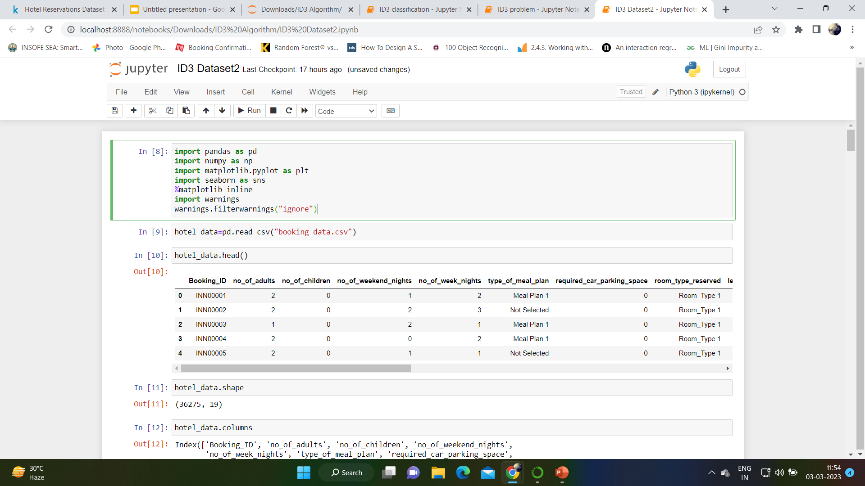
STEP-1
Importing all required libraries like pandas , numpy etc.
Load csv data in python and read the dataset.
Therefore, the dataset consists of 36275 rows and 19 columns.
Checking the information and Dtypes of attributes.

Slide 5
STEP-2 PRE-PROCESSING
In Data-preprocessing, we are checking the unique values for all the attributes.
We have checked the null values using”df.isnull().sum()”.Therefore there no null values.
We have checked the duplicate values using”df.duplicated().sum()”.There are no duplicate values in dataset.
We have checked the value_counts for some attributes like”booking_status”etc..

Slide 6
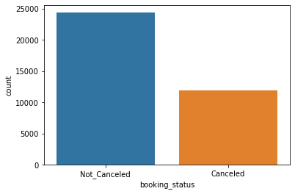
Step-3 EDA
The below graph tells us about no.of bookig_status were canceled and not_cancleled.
From this graph we can say that not_canceled have high count than canceled.

Slide 7
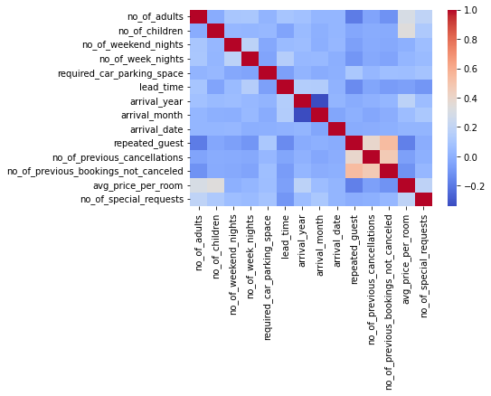
This graph represents the correlation between each attributes.
From this graph we can say repeated_guest no_of_previous_cancellations no_of_previous_bookings_not_canceled

Slide 8
Based on unique values , we have dropped “Booking_Id” as it consist of more number of unique values.
We have calculated correlation using”df.corr()”
Based on Correlation map , we have dropped repeated_guest no_of_previous_cancellations and no_of_previous_bookings_not_canceled.
We have dropped "arrival_date","type_of_meal_plan","lead_time" also.
As our Target variable consist of canceled and not_canceled.we are changing that into 0 and 1 using mapping function
hotel_data['booking_status'] =hotel_data['booking_status'].map({"Not_Canceled":0,"Canceled":1})

Slide 9
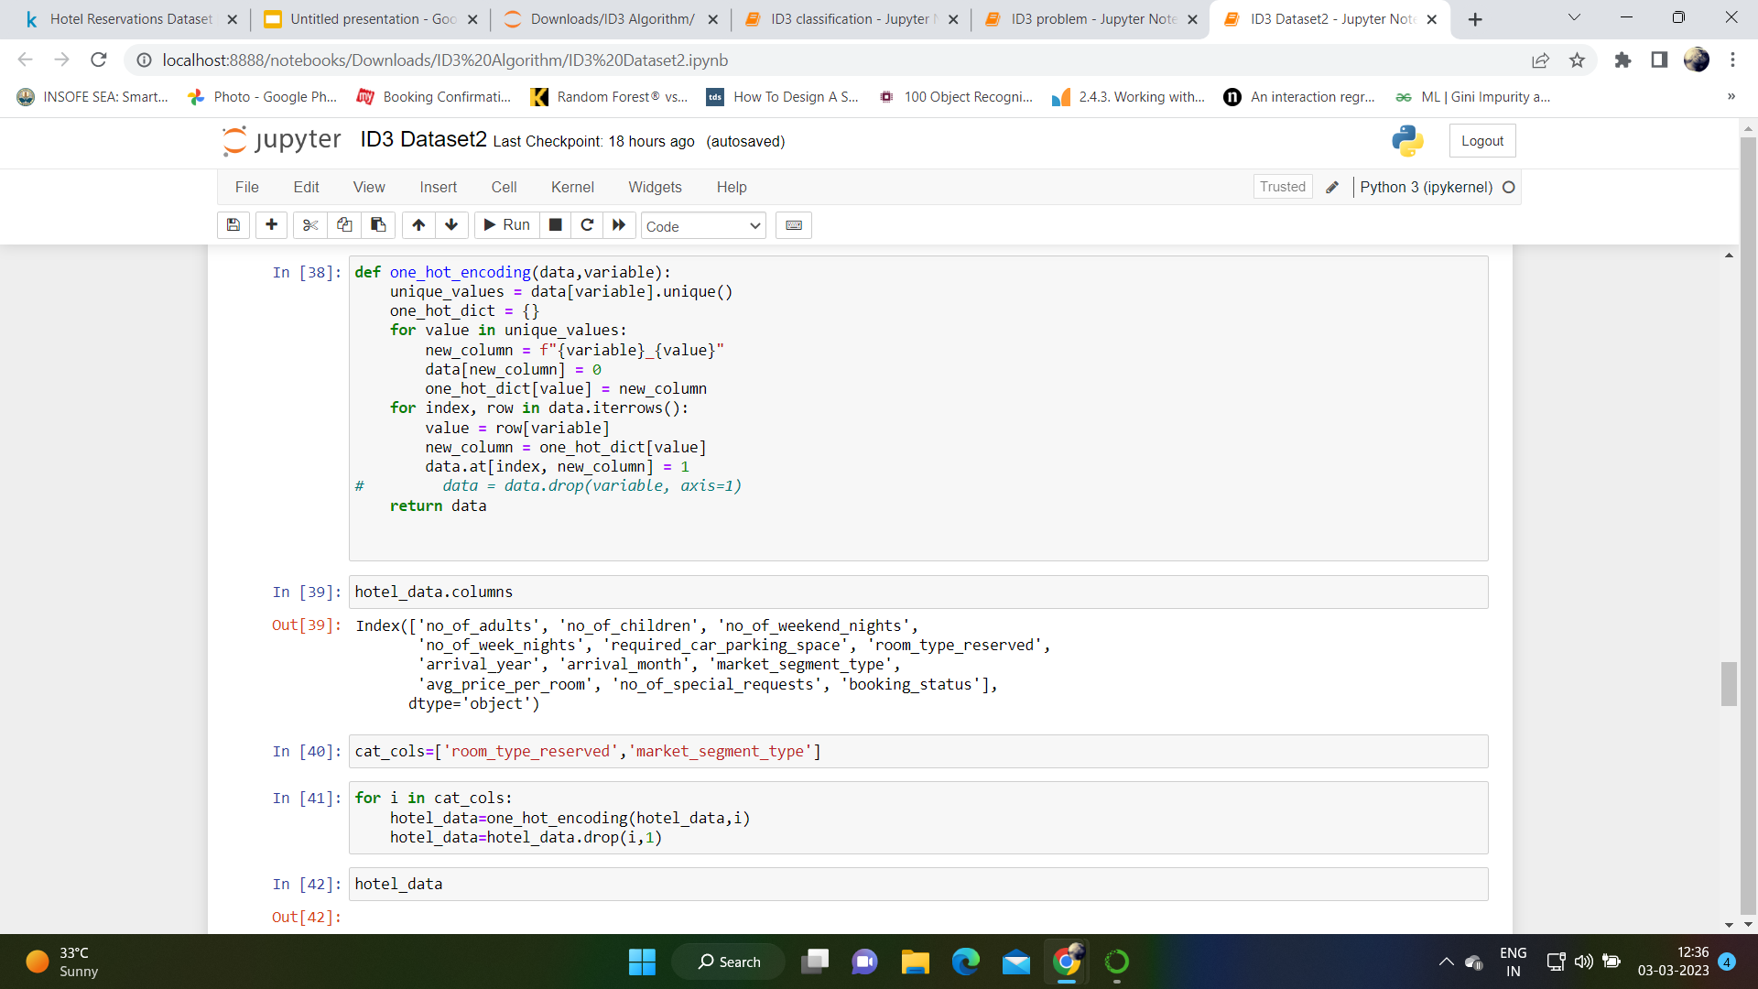
STEP-4 One-Hot Encoding
“def one_hot_encoding(data, variable):” This line defines a function called one_hot_encoding that takes two arguments: a pandas DataFrame called data and a string called variable.

Slide 10
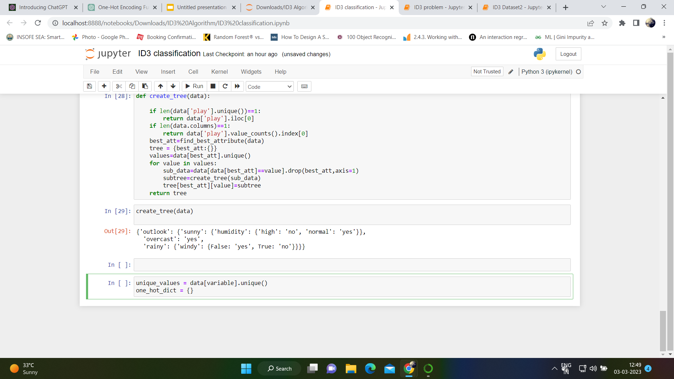
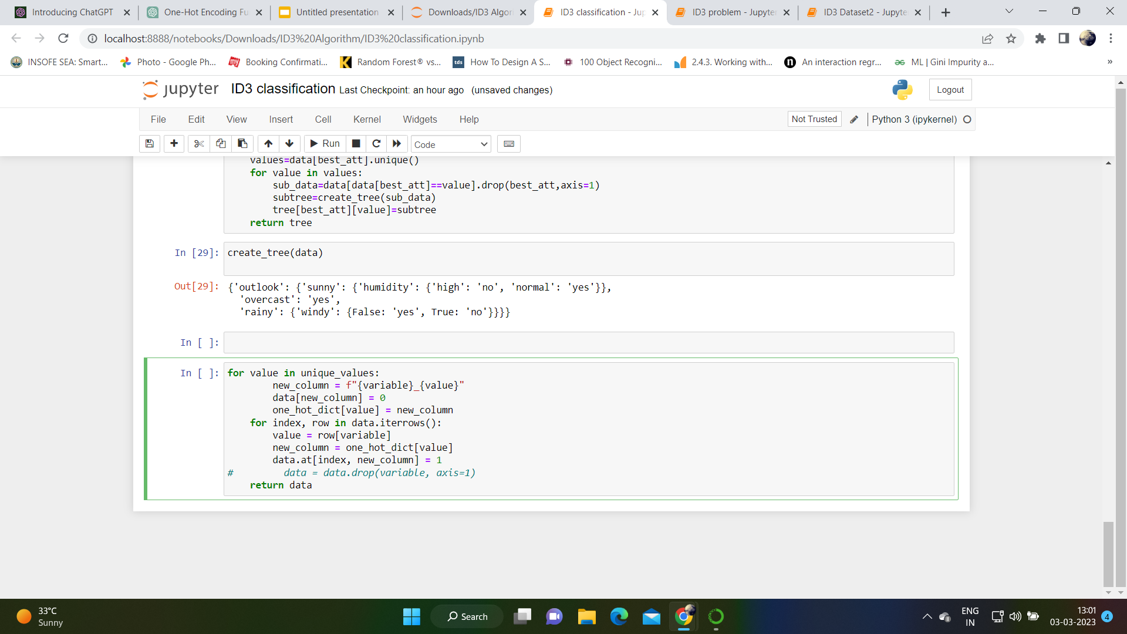
From below code , we can say that the line gets the unique values of the ‘variable’ column in the ‘data’ Dataframe.
The above code initializes an empty dictionary called “one_hot_dict”.
This dictionary will be used to store the mapping between the original categorical values and their corresponding one-hot encoded column names.
Here, for loop creates a new ohe column for each unique value in the ‘variable’.

Slide 11
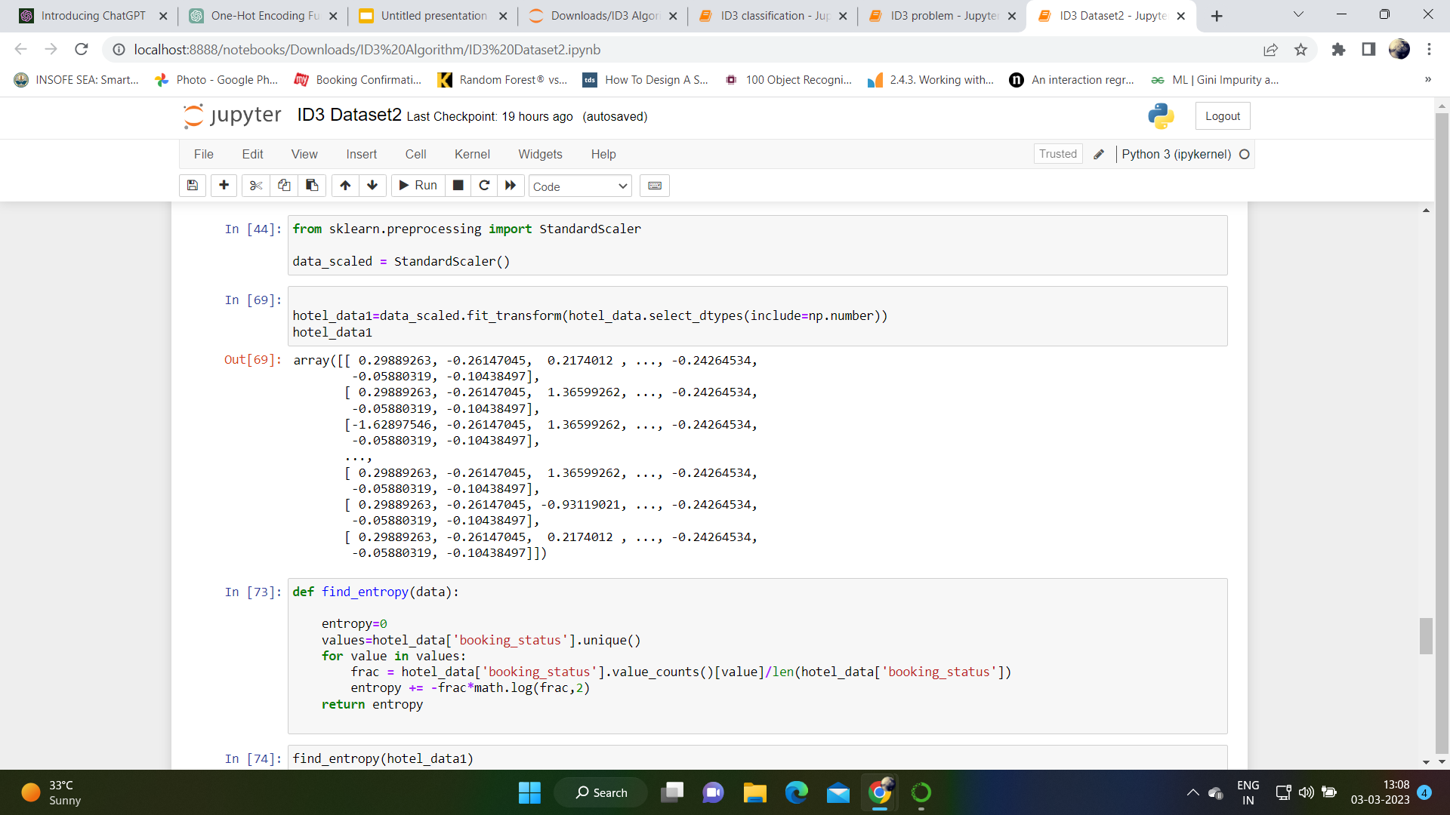
STEP-5 StandardScaler
StandardScaler is a preprocessing technique used in machine learning to standardize or scale the features in a dataset. It is used to transform the data so that it has zero mean and unit variance, and it helps to ensure that all features have the same scale.

Slide 12
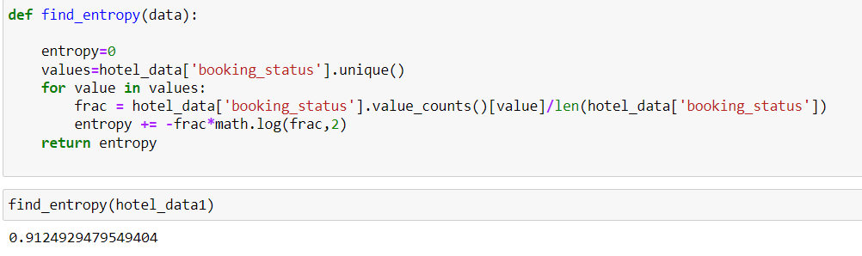
STEP-6 Code for decision tree using ID3 from scratch
To calculate the entropy:
We are defining a function called find_entropy that takes a pandas DataFrame called data as input.
We are initializing the entropy value to 0
“values = hotel_data['booking_status'].unique()”.This line gets the unique values of the booking_status column in the hotel_data DataFrame. These unique values will be used to calculate the entropy.

Slide 13
“frac = hotel_data['booking_status'].value_counts()[value]/len(hotel_data['booking_status'])”.
The above line calculates the fraction of data points in the booking_status column that have the current value, value. It does this by getting the count of each unique value in the column using the .value_counts() method, and dividing it by the total number of data points in the column.
entropy += -frac*math.log(frac,2)
This line calculates the contribution of the current value to the overall entropy of the dataset, and adds it to the entropy variable. It does this using the formula -p*log2(p), where p is the fraction of data points with the current value, and log2 is the base-2 logarithm.

Slide 14
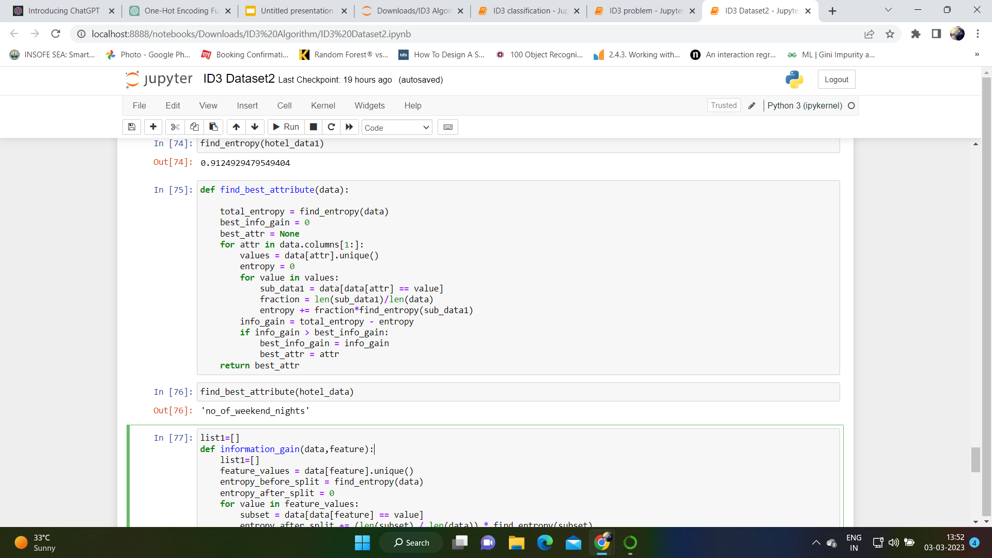
To calculate best attribute:
“total_entropy = find_entropy(data)” calculates the total entropy of the dataset “data” using the “find_entropy” function and stores it in the variable “total_entropy”.
The entropy of the current attribute attr by looping over its unique values and calculating the entropy of the subset of data that contains each value. The entropy is calculated using the find_entropy function, and is weighted by the fraction of data points that have the current value.
The info_gain calculates the information gain of the current attribute attr by subtracting its entropy from the total entropy of the dataset.

Slide 15
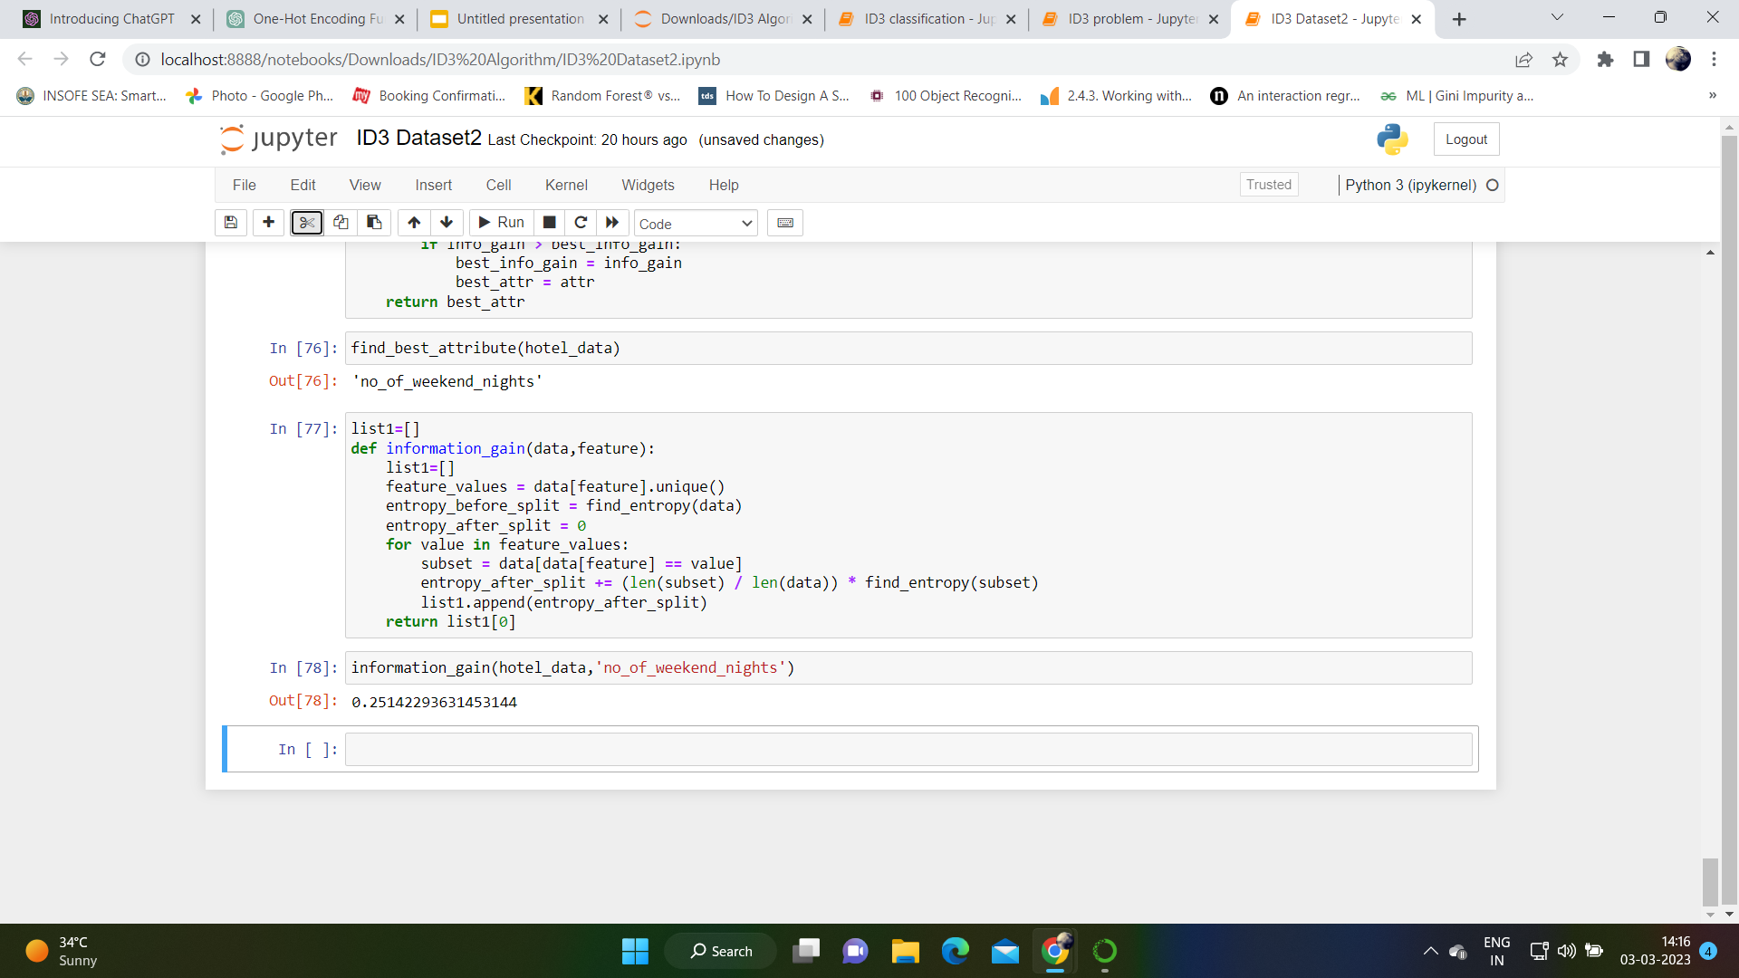
To calculate Information gain:

Slide 16
We are initializing an empty list called “list1” and defining a function called “information_gain” that takes pandas a dataframe called “data” and feature as input.
The unique values of the feature from the DataFrame and stores them in the variable feature_values.
We calculate the entropy before and after splitting the data on the feature. The entropy before splitting is calculated using the find_entropy function, and is stored in the variable entropy_before_split. The entropy after splitting is initialized to 0 and will be calculated in the next loop.

